Slide 1
Capstone Design
Team 3
20163704
20161344
20164245
Park JuHyeon
Heo JeongWoo
Hong Jin

Slide 2
Contents
1.
Project & Team Information
Introduction & Motivation
Goal
Development & Implementation Contents
Project Schedule & Roles
Others
2.
3.
4.
5.
6.

Slide 3
1.
Project & Team Information

Slide 4
1
Project & Team Information
Project Title
Smoothie
“Smoothie” is a Photo Edit Program,
We select this project’s title to emphasize feeling of ‘Smooth’.

Slide 5
1
Project & Team Information
Team name & Members
Team 3 – 316
Team Members – Park JuHyeon, Heo JeongWoo, Hong Jin
Three people whose student numbers are 16.

Slide 6
2.
Introduction & Motivation

Slide 7
2
Introduction & Motivation
Introduction
Smoothie
We are going to make a program that allows users to create smoother images by using deep learning for a major function called a Lasso.
With only a few number of checkpoints, users can produce the image that is much smoother.

Slide 8
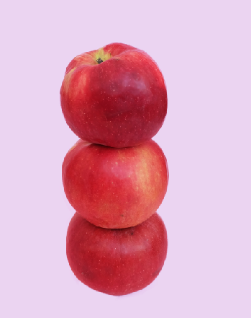
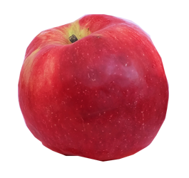
2
Introduction & Motivation
Motivation
It's necessary, but it's too, too uncomfortable.

Slide 9
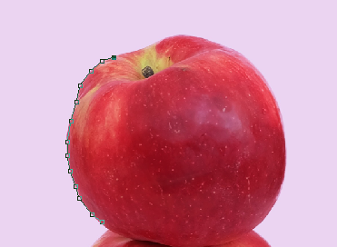
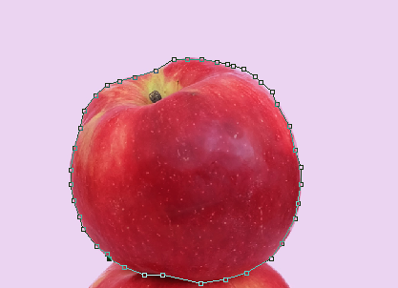
2
Introduction & Motivation
Motivation

Slide 10
3.
Goal

Slide 11
3
Goal
Goal
Improve the speed and accuracy of the Lasso function.
Provide a variety of image editing functions
Minimize program errors

Slide 12
4.
Development & Implementation Contents

Slide 13
4
Development & Implementation Contents
Development & Implementation Contents
Lasso Function
Show areas of lasso based on learning data.
Provides a convenient way to use by putting a small number of points (approximately 3,4).
Learning from a variety of datasets (released in detail later)

Slide 14
4
Development & Implementation Contents
Development & Implementation Contents
Image Editing Function
Develop image editing programs using Qt.
Develops other useful features such as layers, paints, brushes, trims, resizing, spoid, text, erasers, etc.

Slide 15
4
Development & Implementation Contents
Development & Implementation Contents
Error Minimization With TDD
Recognized the importance of error minimization through last Capstone design class.
We will try to minimize errors by writing as many TCs as possible with TDD.
We will release TCs often.

Slide 16
5.
Project Schedule & Roles

Slide 17
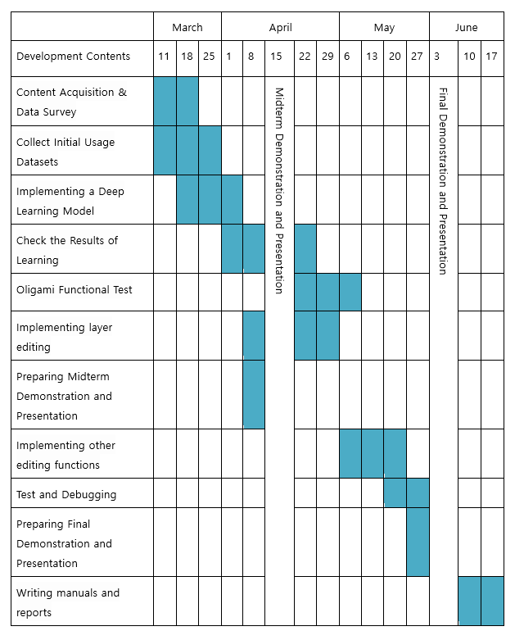
5
Project Schedule & Roles
Project Schedule

Slide 18
5
Project Schedule & Roles
Roles
Park JuHyeon
Heo JeongWoo
Hong Jin
Collect Learning Datasets
Implementing a Learning Model
Layer Function Implementation
Test
Collecting Learning Datasets
Implementing a Learning Model
Implementing sizing
Test
Collecting Learning Datasets
Learning data to model
Implementing Qt UI and basic functions
Test

Slide 19
6.
Others

Slide 20
6
Others
Market Research
Photoshop
Point by point to draw out an object.
Not only is it taking a long time, and it takes a lot of hands, the results also differ depending on individual ability.

Slide 21
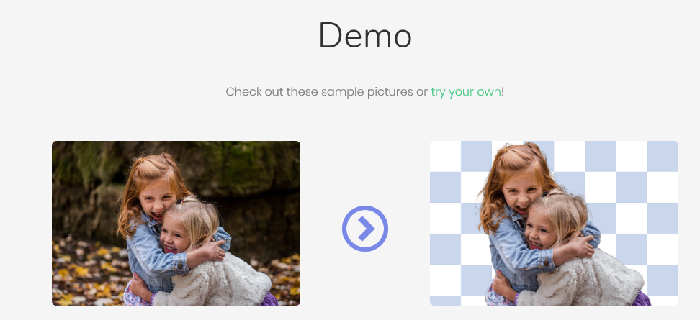
6
Others
Market Research
Remove.bg
Free.
Use background erasing method.
Unable to set the desired part and only people can be recognized

Slide 22
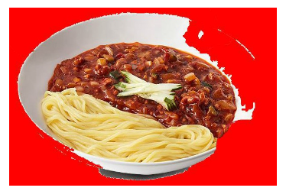
6
Others
Market Research
Photopea
Free.
Provide basic image editing functions in Web.
Magnetic Lasso function exists but it’s too weak.

Slide 23
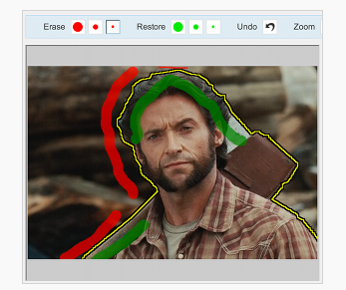
6
Others
Market Research
BackGround Burner
Remove background by separating regions in two colors.
Good performance for simple images, but not for complex images.
It can’t be edited and only available as JPG, PNG.

Slide 24
7.
Q&A

